Slide 1


Stack Overflow Knowledge Graph Analytics
Using Distributed Graph Processing — Minor Project in Big Data Analytics
DEPARTMENT OF COMPUTER SCIENCE & ENGINEERING
Om Dhondge
Ayush Kumar
Reg. No. 230962282
Reg. No. 230962170
Kumar Satyam
Reg. No. 230962226
Guide: Dr. Mayur Pandya | Date of Submission: 16th April 2026

Slide 2

Introduction
Stack Overflow has been the go-to Q&A platform for programmers since 2008. As of 2025, it hosts over 23 million registered accounts and more than 58 million questions and answers. The December 2025 data dump alone weighs 100+ GB across 364 XML files.
What makes this data compelling is its structure. Every answer links two users through a shared topic. Every tag ties a question to a technology. Every upvote signals trust. Together, these interactions form a sprawling, multi-layered graph which is a network of who knows what, who helps whom, and which technologies sit close together in practice.
Standard tools like Pandas cannot answer: "Which user bridges the Python and JavaScript communities?" for that, you need distributed graph algorithms at scale.

Slide 3




What This Project Builds
We take the Stack Overflow data dump and turn it into a usable knowledge graph — from raw XML to interactive visualisations.
Parse XML
Build Graph
Clean and ingest raw Stack Overflow dump files
Multi-relational graph: users, questions, tags
Run Analytics
Visualise
PageRank, community detection via PySpark GraphFrames
Neo4j, Gephi, and a Streamlit dashboard
The end goal is practical: ranked expert lists by structural importance, mapped technology communities, and network visualisations showing how the developer knowledge landscape is actually organised.

Slide 4
Literature Review
Developer Network Analysis
Graph Processing at Scale with Spark
Vasilescu et al. (2015) found measurable links between SO participation and GitHub activity. Later work identified "super-users" which are knowledge brokers bridging separate communities. Key insight: Stack Overflow's built-in reputation score misses structural nuance.
GraphFrames (Dave et al., UC Berkeley, 2016) layers graph operations on Spark SQL DataFrames. Apostol et al. (2024) confirmed community detection algorithms scale linearly with data size which allows for predictable scaling for tens-of-gigabytes datasets.
Knowledge Extraction from Stack Overflow
What This Project Adds
Ye et al. (2016) used tag co-occurrence to map technology relationships. Barua, Thomas & Hassan (2014) applied topic modelling to track how developer conversations shift over time.
Most existing studies use small data slices or single-machine tools like NetworkX (capped at ~100K nodes). Our project delivers the full end-to-end pipeline, gigabytes of XML to graph database, as one reproducible system.

Slide 5
Problem Statement
The Stack Overflow dump contains a detailed record of developer knowledge exchange, but raw data is stored as flat XML tables — Posts, Users, Tags, Votes, Comments — with no explicit graph structure. Relationships are implicit. Four technical problems must be solved:
1
2
Scalable Parsing
Graph Construction
98 GB of XML requires a distributed approach which Pandas DataFrames simply cannot handle it.
Derive edges from relational data: user-answers-question, question-tagged-with-tag, user-votes-on-post.
3
4
Algorithms at Scale
Usable Outputs
PageRank and Label Propagation require repeated iterations over millions of nodes, hence, single-machine libraries become impractical.
Results must go beyond raw CSVs with ranked expert lists, visual community maps, and an interactive dashboard.

Slide 6
Project Objectives
01
02
ETL Pipeline
Knowledge Graph
PySpark-based parsing of XML dumps into partitioned Parquet files.
Multi-relational graph: User↔Question (expertise), Question↔Tag (topic), User↔Post (reputation).
03
04
Graph Analytics
Neo4j Integration
PageRank, Label Propagation, Connected Components, and Triangle Count via Spark GraphFrames.
Interactive Cypher queries with shortest paths, cross-domain user identification.
05
06
Visualisations
Benchmarking
Gephi network layouts + Streamlit dashboard with leaderboards, heatmaps, and trend charts.
Pipeline tested at 1 GB, 5 GB, and 10 GB scales vs. NetworkX single-machine baseline.

Slide 7
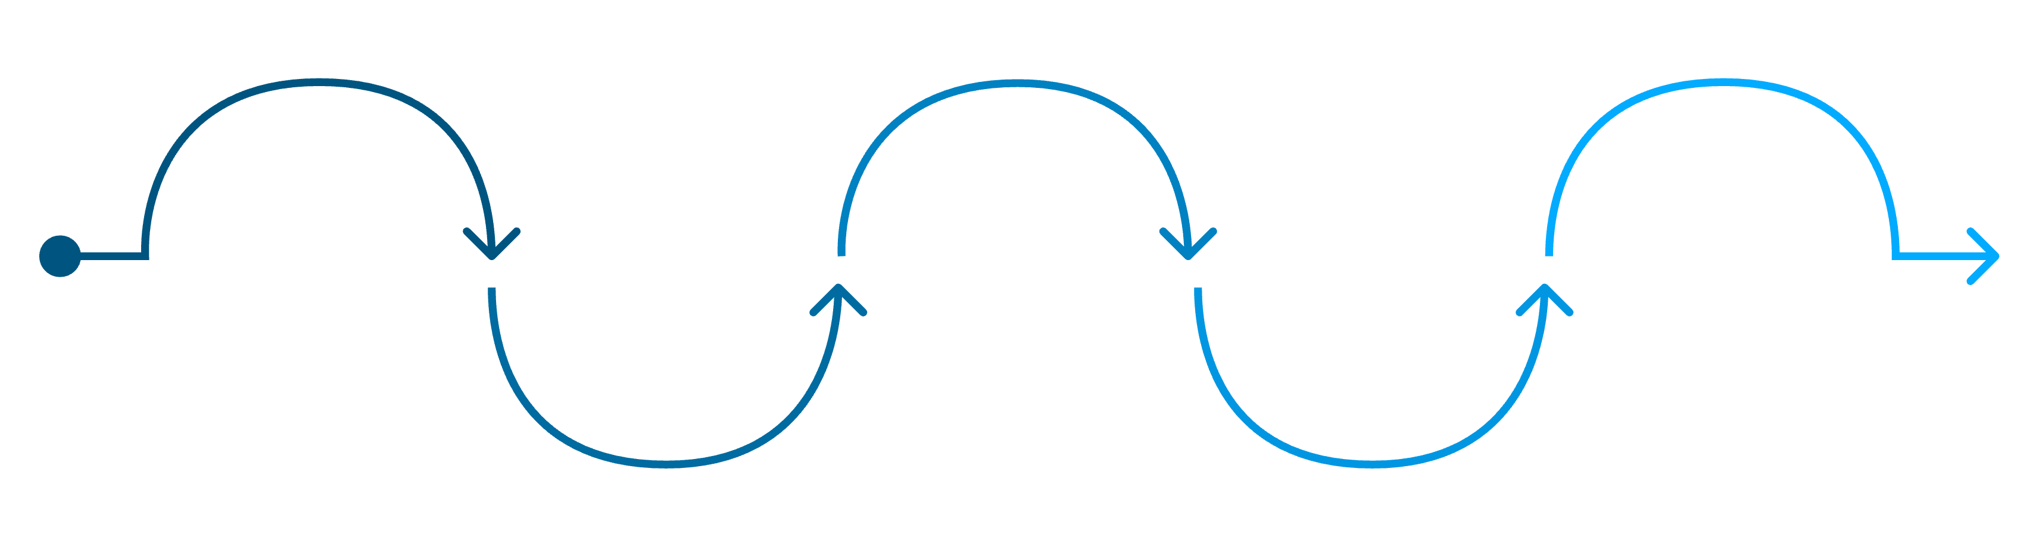
Methodology: Five-Phase Pipeline
Analytics & Viz
Parsing
Data Acquisition
Graph Construction
Run graph analytics and create dashboards
Benchmarking
Parse XML via lxml and PySpark to Parquet
Collect SO dump and select subset
Build edge lists and load into graphs
Evaluate results and produce report
Weeks 1–2: Data & Graph
Weeks 2–4: Analytics & Output
Download SO dump, select 5–10 GB working subset (top 50 tags, last 2–3 years). Parse XML with lxml → PySpark → Parquet. Build edge lists: answers, tags, votes. Load into GraphFrames and Neo4j.
Run PageRank (20 iterations, damping 0.85), Label Propagation, Connected Components, Triangle Count. Export GEXF for Gephi. Build Streamlit dashboard with 4 views. Benchmark at 1/5/10 GB vs. NetworkX baseline.

Slide 8
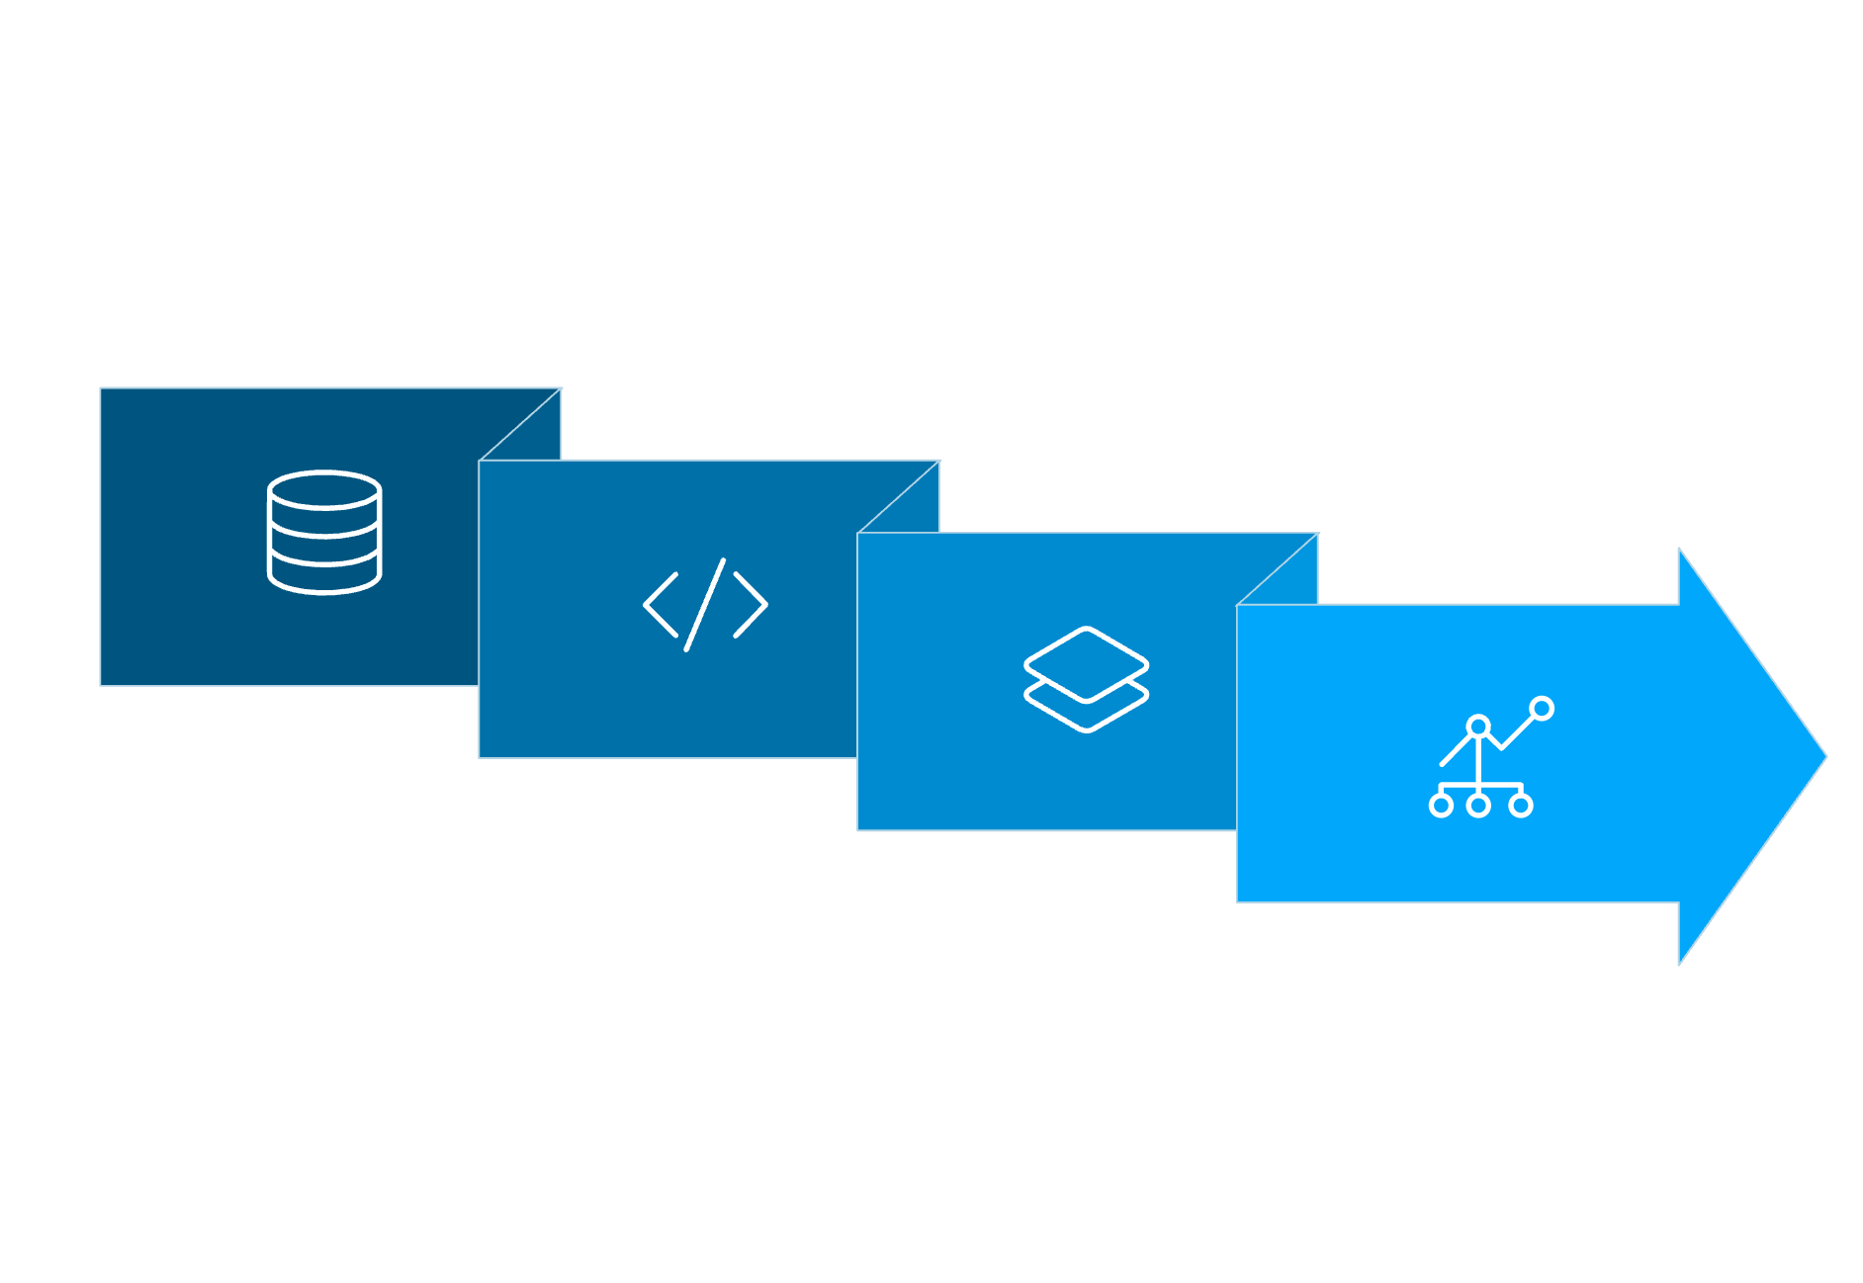
Technology Stack
Data Source & Storage
Ingestion & Processing
Stack Overflow XML Dump (~5–10 GB working subset), Parquet (local/HDFS), Neo4j graph database
Python lxml for XML parsing, PySpark DataFrames for schema enforcement and distributed ETL
Graph Analytics
Visualisation
Spark GraphFrames for PageRank, LPA, Connected Components; SparkSQL + Cypher for querying
Gephi for network layouts, Streamlit + Plotly for interactive expert leaderboards and trend charts
Parse & ETL
Analyze & Visualize
XML Dump
Store Graph & Parquet

Slide 9

Current Progress
100GB+
6.7GB
1GB
Raw Data Acquired
Parquet Output
Extracted Images
Full Stack Overflow XML dump downloaded from the Stack Exchange data portal
Clean question-answer pairs after preprocessing 100+ GB of raw XML data
Images extracted from Stack Overflow posts; broken and corrupted links skipped
Preprocessing scripts systematically extract only answered question-answer pairs. Over 100 GB of raw XML has been successfully converted to a clean, analysis-ready Parquet dataset.

Slide 10
Key Takeaways & Next Steps
What We Are Building
Immediate Next Steps
End-to-end distributed graph analytics pipeline on real-world 100 GB+ data
Multi-relational knowledge graph: users, questions, and technology tags
Structural expert ranking beyond reputation scores using PageRank
Technology community maps via Label Propagation and Gephi visualisation
Build edge lists from the 6.7 GB Parquet dataset using PySpark joins
Load graph into Spark GraphFrames and Neo4j for analytics and querying
Execute PageRank, LPA, and Connected Components algorithms
Develop Streamlit dashboard and run benchmarking at 1/5/10 GB scales
Guide
Dr. Mayur Pandya - School of Computer Engineering, Submission: 18th April 2026
This project demonstrates that structural graph analysis reveals insights about developer expertise and technology ecosystems that flat metrics and reputation scores simply cannot capture.

